Slide 1
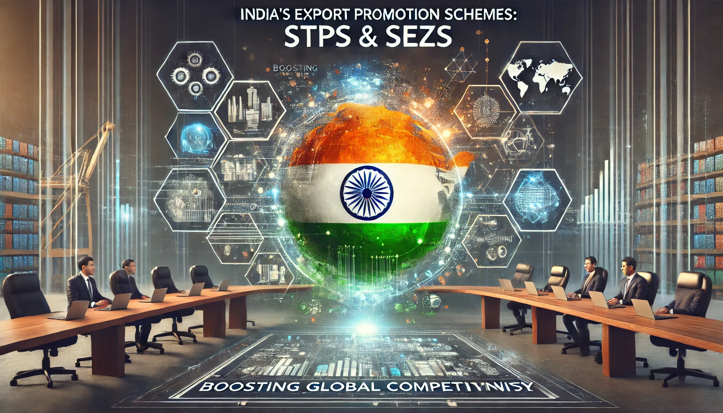
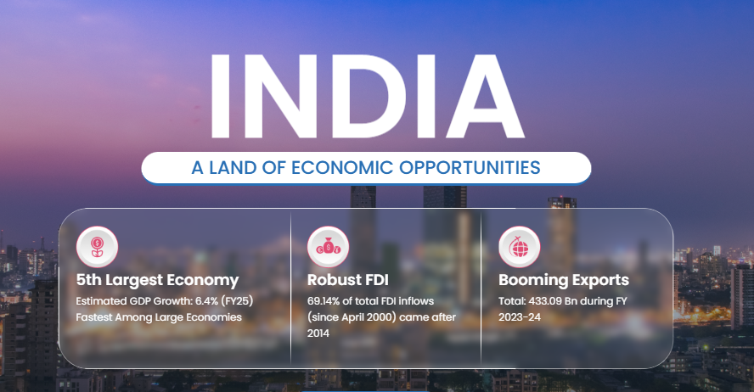
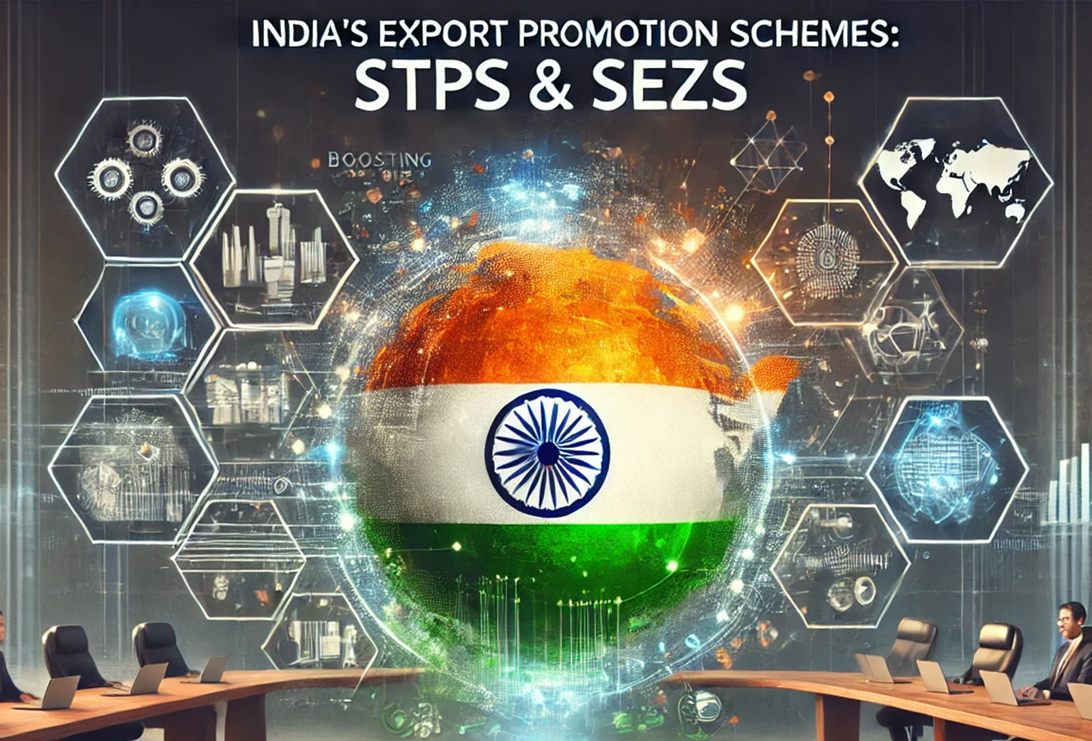


Slide 2

India’s Export Promotion Schemes: STPs & SEZs
Boosting Global Competitiveness

Slide 3

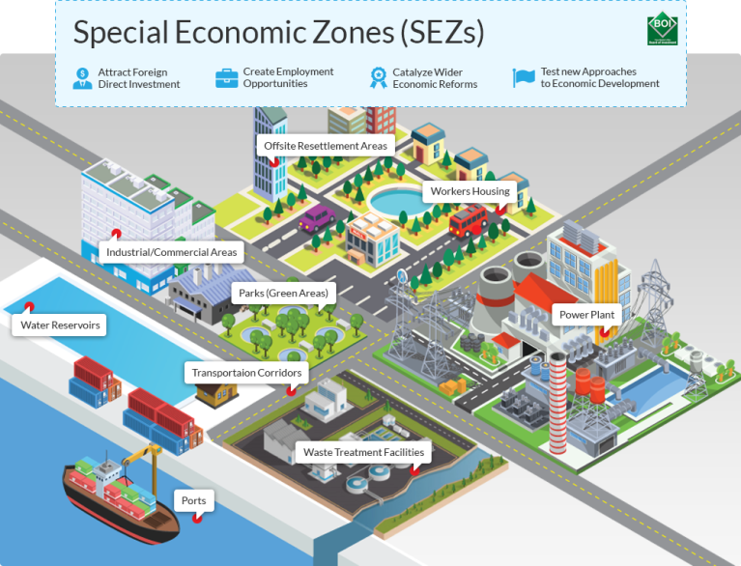

Real-World Impact of STPs & SEZs
• Infosys, leveraging the STP model, achieved $15.4B in exports during 2022-23.
• SEZs contributed to 20% of India’s total exports in the same period.
These figures underscore how these schemes are key drivers of global trade.

Slide 4
STP Scheme: Digital Export Engine
STP Registration Flowchart
Start
Begin the STP registration process.
Eligibility Check
Ensure the unit qualifies for STP registration (e.g., software development, IT services, etc.).
Prepare Documents
Gather required documents:
Application form (Form A).
Project report.
Memorandum of Association (MOA) and Articles of Association (AOA).
Board resolution for STP registration.
PAN card, GST registration, and other legal documents.
Online Application
Submit the application on the STPI portal (https://www.stpi.in).
Application Review
STPI reviews the application and documents for completeness and accuracy.

Slide 5
Clarifications/Corrections (if any)
If STPI requests additional information or corrections, provide the required details.
Site Inspection
STPI may conduct a site inspection of the proposed unit.
Approval/Rejection
STPI approves or rejects the application based on the review and inspection.
Approval Granted
If approved, the unit receives an STP registration certificate.
Commence Operations
Start operations under the STP scheme and avail benefits (e.g., tax exemptions, customs duty benefits).
Compliance
Submit monthly/quarterly/annual returns and reports to STPI as required.
End
Process complete.

Slide 6
STP Scheme: Digital Export Engine
Since its inception in 1991 by the Ministry of Electronics & IT, the STP scheme has transformed India's export landscape.
Key Features:
• Tax holidays and a streamlined single-window clearance process
• 100% FDI allowed in IT/ITES sectors
• Over 600 registered units as of 2023
• Focus on software development, R&D, and innovation

Slide 7
Why STPs? Key Incentives
STPs offer a suite of attractive benefits that have made them a cornerstone of India's export strategy:
• 10-year income tax exemption
• Duty-free imports for advanced technology
• Simplified compliance procedures
• Robust cloud infrastructure support
• Enhanced export revenue retention (contributing ~45% to IT exports)

Slide 8
SEZ Scheme: Trade & Investment Hubs
Launched in 2005 under the SEZ Act, Special Economic Zones have emerged as pivotal trade and investment hubs.
Highlights:
• Over 270 operational SEZs as of 2023
• Significant tax breaks and GST exemptions
• Boost to export-oriented manufacturing and services
• Strategic clusters in states like Gujarat and Tamil Nadu

Slide 9
SEZ Advantages for Exporters
SEZs offer compelling advantages to exporters, including:
• A 15-year corporate tax holiday
• Duty-free import and export privileges
• An FDI framework that requires no additional licensing
• Simplified labor laws
In 2022-23, SEZ exports reached an impressive ₹7.5 lakh crore.

Slide 10
Key Differences: STP vs. SEZ
A side-by-side comparison of the two schemes:
• **Sector Focus:** STPs specialize in IT/Software, while SEZs cater to multiple sectors.
• **Tax Holiday:** STPs provide a 10-year benefit, compared to 15 years for SEZs.
• **Location:** STPs are typically situated in dedicated parks, whereas SEZs span larger geographic zones.

Slide 11
Driving Growth & Employment
Together, STPs and SEZs have fueled significant economic growth:
• STPs have generated approximately 4.5 million jobs in the IT sector.
• SEZs have created over 2 million direct jobs as of 2023.
• Combined, these initiatives support exports valued at around ₹20 lakh crore.

Slide 12
Summary & Next Steps
In summary, STPs and SEZs are foundational pillars of India's export growth and economic progress.
They provide a robust platform for future initiatives such as 'Make in India' and support for startups.
Call to Action:
• Explore case studies (e.g., Wipro's success within an STP).
• Stay updated on forthcoming policy changes in 2024.

Slide 13
Data Sources
• STPI Annual Report (2022-23)
• SEZ India Portal (2023)
• Ministry of Commerce & Industry
Visual Suggestion: Include government logos (STPI, SEZ, MeitY) to reinforce credibility.

